Slide 1



DemoBlaze E-Commerce Website
Automation Testing
using Selenium with Python
Team: Next Gen QA
Git Hub Link - https://github.com/Kalyan1511/Demoblaze_Automation_NextgenQA.git
Presented By:
1.Kalyan Reddy Annepalli – B.Tech – kalyanreddyannepalli46@gmail.com
2. Manasa Jonnadula – B.Tech – jonnadulamanasa47@gmail.com
3. Bhavana Bhatta – B.Tech – bhavanabhatta25@gmail.com
4. Sandeep Yelisetty – B.Tech – sandeepyelisetty111@gmail.com
5. Kavya Eluri – B.Tech – kavyasrieluri1@gmail.com
6. Kalyani Kadudula – B.Tech – kalyanixyz1931@gmail.com
7. Dharani Dogiparthi – B.Tech – dogiparthidharani@gmail.com
Next Gen QA @ Wipro - BY KAVYA
1

Slide 2
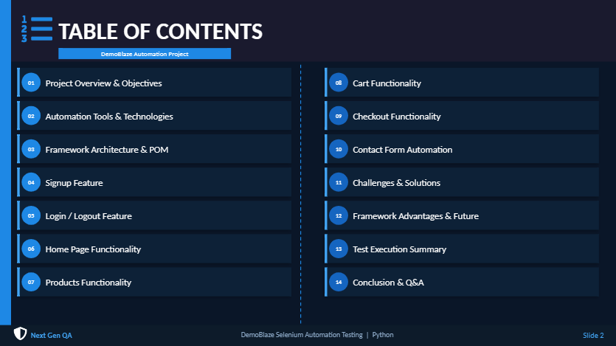

Slide 3
Project Overview & Objectives
WIPRO
Project Introduction
Core Objectives
The DemoBlaze Automation Testing project automates the complete e-commerce workflow of the DemoBlaze web application using Selenium WebDriver and Python.
DemoBlaze is a demo e-commerce website with features like user registration, login, product browsing, cart management, and order placement — ideal for end-to-end automation testing.
1
Automate Core Functionalities
Cover signup, login, product browsing, cart, checkout & contact forms
2
Reduce Manual Effort
Eliminate repetitive manual test execution with automated scripts
3
Improve Accuracy
Achieve consistent test results free of human error
4
Validate User Workflows
End-to-end testing of real user journeys on the platform
Next Gen QA - BY KAVYA
3

Slide 4








Automation Tools & Technologies Used
WIPRO
Selenium WebDriver
Python
VS Code IDE
PyTest / Unittest
Browser automation engine
Primary scripting language
Development environment
Test framework
ChromeDriver
Git & GitHub
Page Object Model
HTML Reports
Browser driver for Chrome
Version control
Design pattern (POM)
Test result reporting
Next Gen QA - BY KALYAN
4

Slide 5
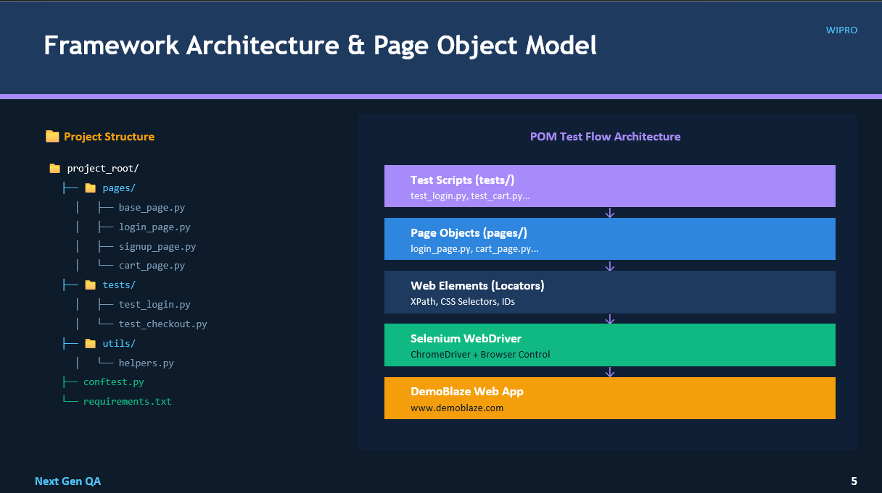

Slide 6




Signup Feature Automation
WIPRO
Dynamic User Creation
Signup Workflow
Automatically generates new user accounts with unique credentials for each test run
Open DemoBlaze
Random Username Generation
Click Sign Up
Creates unique usernames using timestamp or random string to avoid conflicts
Enter Username
Alert Handling Validation
Enter Password
Captures and verifies browser alert messages after signup actions
Click Register
Handle Alert
Successful Signup Verification
Validates that user registration completes successfully with confirmation
Verify Success
Next Gen QA - BY MANASA
6

Slide 7
Login Feature / Logout Feature
WIPRO
🔐 LOGIN
🚪 LOGOUT
1
Session Login Flow
1
Logout Validation
Simulates user login within an active browser session
Verifies user can successfully log out from the application
2
Credential Verification
2
Session Termination
Tests valid and invalid credential combinations
Confirms session data is cleared after logout
3
Login Confirmation
3
UI State Verification
Verifies username shown in navigation post-login
Checks navigation reverts to guest state post-logout
4
Session Handling
4
Re-login Testing
Ensures session persists across page navigations
Validates user can log back in after logout successfully
Next Gen QA - BY MANASA
7

Slide 8

Home Page Functionality
WIPRO
Homepage Exploration
Navigation Testing
Automated navigation and rendering verification of the DemoBlaze homepage on load
Validates all navigation links, category menus, and header/footer elements work correctly
Scrolling Functionality
UI Element Verification
Tests page scroll behavior including carousel navigation and lazy-loaded product images
Verifies all key UI elements (logo, nav, buttons, carousel) are visible and functional
Next Gen QA - BY SANDEEP
8

Slide 9
Products Functionality
WIPRO
Mobiles
Laptops
Monitors
Browse mobile category
Browse laptop category
Browse monitors section
Validate product listing
Validate product cards
Validate monitor listing
Product detail page
Laptop product details
Monitor product page
Click & navigate products
Price & specs verification
Navigation testing
Product Navigation Flow:
All Products → Category → Product Page → Add to Cart
Next Gen QA - BY SANDEEP
9

Slide 10

Cart Functionality Automation
WIPRO
Add Product to Cart
Cart Automation Flow
1
Automates product selection and add-to-cart button click
Select Product Category
Cart Validation
↓
2
Click on Product Item
Verifies cart page loads correctly with expected product count
↓
Click Add to Cart
Product Verification
3
Confirms correct product name and price appear in cart
↓
Navigate to Cart Page
Cart Workflow
↓
4
Verify Product in Cart
End-to-end cart automation from product selection to order
Next Gen QA - BY KALYANI
10

Slide 11
Checkout Functionality Automation
WIPRO
1
2
3
4
5
Cart
Place Order
Fill Form
Purchase
Verify
Item added
Click button
User details
Click confirm
Success msg
Place Order Automation
Purchase Confirmation
✓
✓
Automates the Place Order button click from cart to initiate checkout
Verifies purchase confirmation modal appears with order details
User Details Form
Order Success Message
✓
✓
Fills name, country, city, credit card, month, year in order form
Validates Thank You message and purchase ID in confirmation popup
Next Gen QA - BY KALYANI
11

Slide 12

Contact Functionality Automation
WIPRO
Contact Form
Contact Form Automation
Automates navigation to Contact page and form element interaction
Contact Email:
user@example.com
Form Submission
Name:
Fills and submits contact form with email, name and message fields
Test User
Message:
Alert Message Handling
Automated test message...
Captures and verifies success/error alert after form submission
Send Message
Next Gen QA -BY DHARANI
12

Slide 13
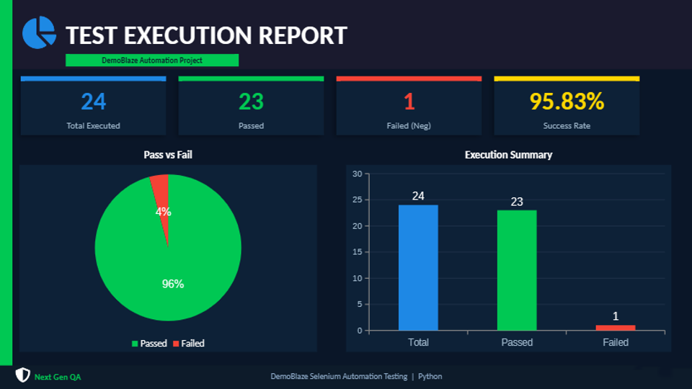

Slide 14
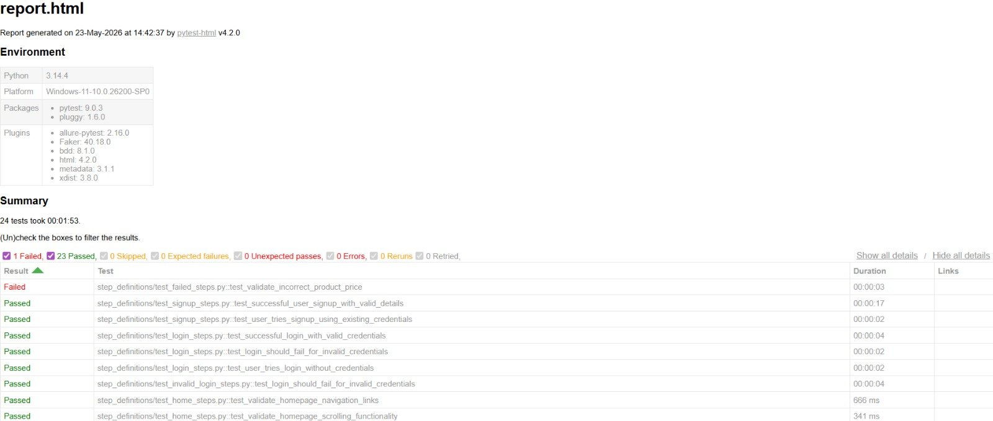

Slide 15
Challenges Faced & Solutions Implemented
WIPRO
⚠ Challenges
✓ Solutions
Dynamic Element Handling
Explicit Waits
Web elements with changing IDs or rendered via AJAX were difficult to locate
Used WebDriverWait with ExpectedConditions to wait for elements dynamically
Alert Synchronization
Alert Handling
Browser alerts appeared asynchronously causing test failures
Implemented switch_to.alert() with try-except for robust alert management
XPath Issues
Robust XPath
Generic or fragile XPath selectors broke with minor UI changes
Built precise XPath with multiple attributes and text-based locators
Timing & Wait Issues
Exception Handling
Race conditions between page load and element interaction
Added try-except blocks and retry logic for flaky test scenarios
Next Gen QA - BY BHAVANA
15

Slide 16



Framework Advantages & Future Enhancements
Framework Advantages
Future Enhancements
Reusable Framework
01
CI/CD with Jenkins
POM-based design makes tests modular and reusable across projects
Integrate tests into Jenkins pipelines for continuous testing on code commits
Faster Execution
02
Cross-Browser Testing
Automated tests run significantly faster than manual testing
Extend coverage to Firefox, Edge, and Safari browsers using WebDriver
Better Maintainability
03
Data-Driven Framework
Centralized locators make updates quick and isolated
Implement parameterized testing with Excel/CSV data inputs
Reduced Manual Effort
04
Reporting Dashboard
Eliminates repetitive manual test cycles saving QA time
Integrate Allure or ExtentReports for rich HTML reporting dashboards
Next Gen QA - BHAVANA
16

Slide 17

Thank You!
Questions & Answers
Team: Next Gen QA
DemoBlaze E-Commerce Automation | Selenium with Python
Next Gen QA @ Wipro - BY BHAVANA
17

